Slide 1


Detect Pneumonia using CNN
[classification of chest X-ray images]

Slide 2
Table of contents
01
Dataset
02
Pre Processing
03
Augmentation
04
Model Definition

Slide 3
Dataset Selection
Brain MRI
Handwriting Recognition
Iris Flower Classification
Pneumonia Detection
Multiple targets
Need for augmentation -> Limited PC processing power
Too small
Binary classification

Slide 4
Data Collection, Cleanup, and Exploration
> Dataset: 5,863 X-ray images in train, test, and val folders.
> Categories: Pneumonia and Normal.
Collected from pediatric patients (ages 1-5).
Quality control and expert grading.
Evaluation by third expert.

Slide 5
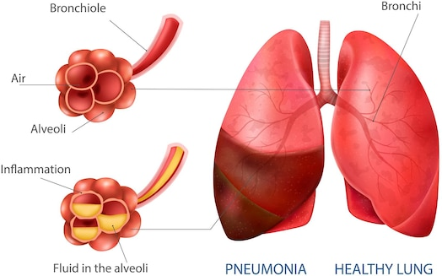
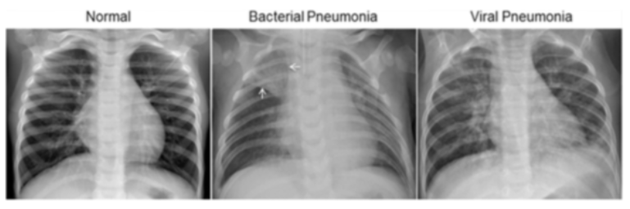
Normal
Pneumonia
Bacterial Pneumonia
Viral Pneumonia

Slide 6
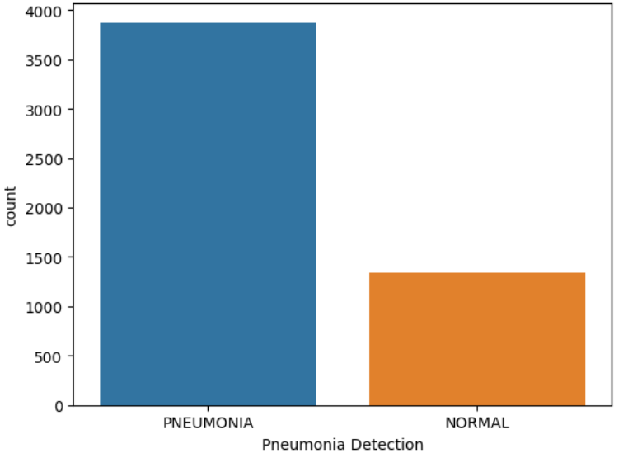
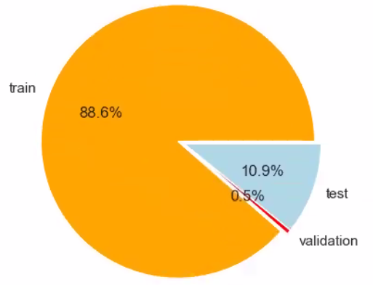
Data Structure

Slide 7
Data Augmentation
Data Preparation
Loaded images using TensorFlow.
Converted images to NumPy arrays and normalized.
Separated into Pneumonia and Normal subsets.
Applied augmentation but needed additional processing power
X-Ray have a standard orientation of images
No real benefit to use augmentation

Slide 8
Model – VGG16
The VGG16 model is a type of deep learning neural network used primarily for image recognition and classification. VGG16 is like a smart software program that can look at pictures and tell you what it sees. It was designed by researchers at Oxford and is known for its simplicity and effectiveness in recognizing different objects in images.
Architecture: it's a deep neural network that consists of 16 layers, including 13 convolutional layers and 3 fully connected layers, which allow it to learn complex patterns and features in images.
High Accuracy
Feature Extraction: commonly used to extract features from images, which can then be used in other machine learning tasks or models.
VGG16 is a reliable and effective model for identifying and classifying images, widely used in both research and practical applications in computer vision.

Slide 9
Model
Definition
Used VGG16 for transfer learning.
Freezed all but the last three layers of the VGG16 model.
Sequential model with additional layers.
Compiled with Adam optimizer and binary cross entropy
Trained for 6 epochs.
Training
Freezing the base model: Prevents the pre-trained weights from being updated, retaining the learned features from the original training dataset.
Adding custom layers: Allows you to adapt the model to your specific task and dataset.
Fine-tuning: Optionally, after initial training, unfreeze some layers and continue training with a lower learning rate to further adapt the pre-trained features to your dataset.
This approach leverages the powerful features learned by VGG16 on large datasets like ImageNet, while also allowing you to customize the model for your specific needs.
Validation
Testing
Test set for performance evaluation.
Prediction
Confusion matrix

Slide 10
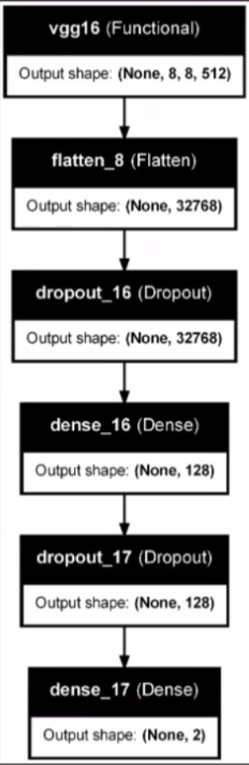
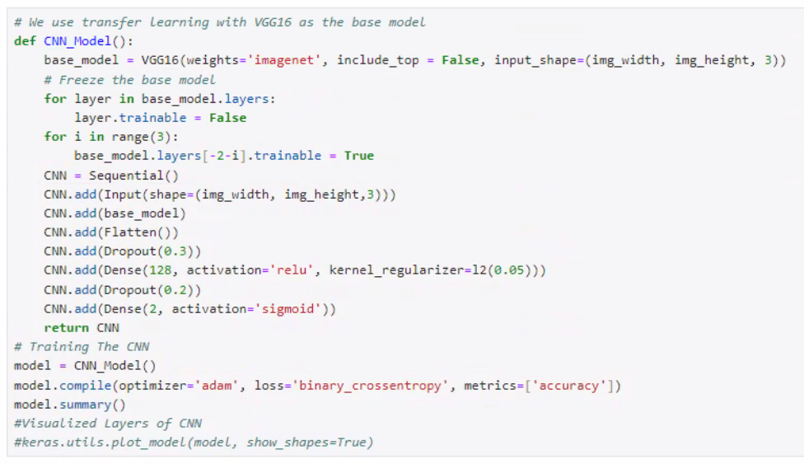
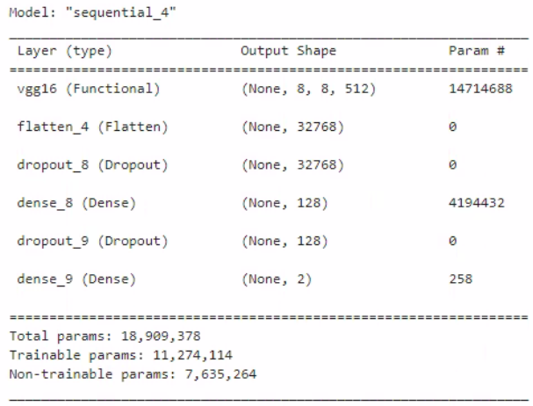
Model Code and Layers
The activation function for the output layer is Sigmoid
The last input layer is Relu

Slide 11
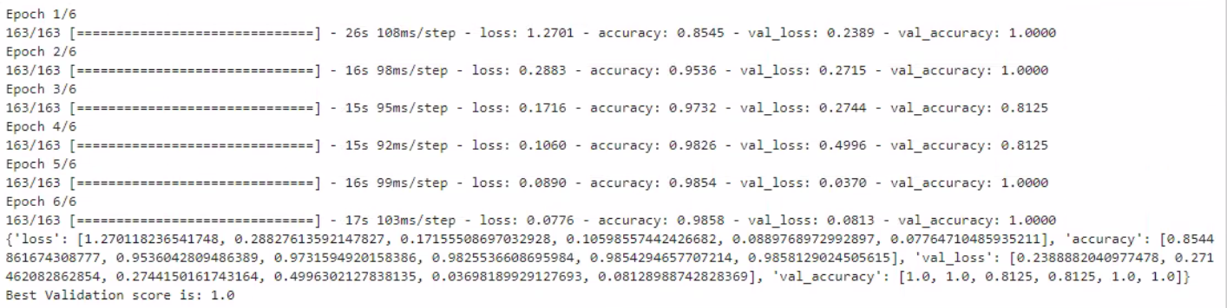
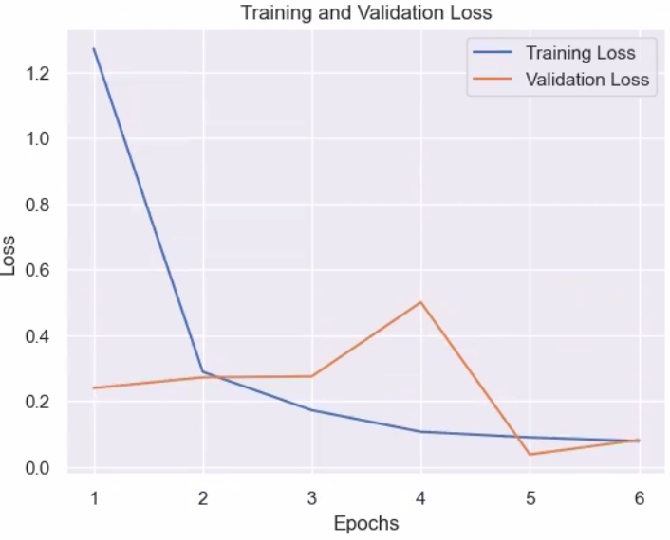
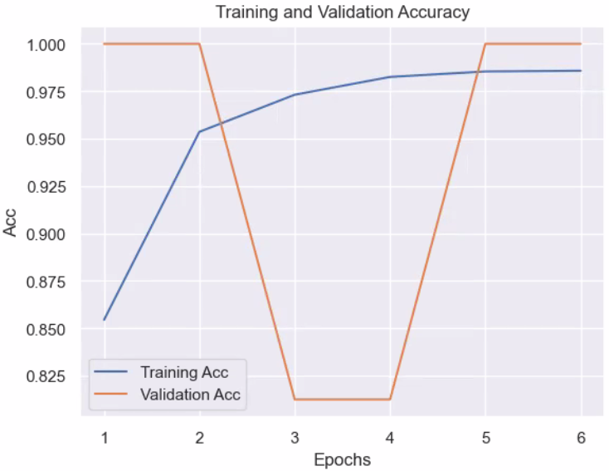
Training and Validation Loss and Accuracy

Slide 12

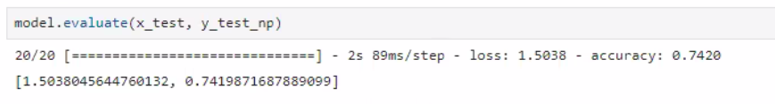
Evaluation
74%
100%
Classification
Validation
Achieved high accuracy in classification
Validation accuracy highlights model effectiveness.

Slide 13
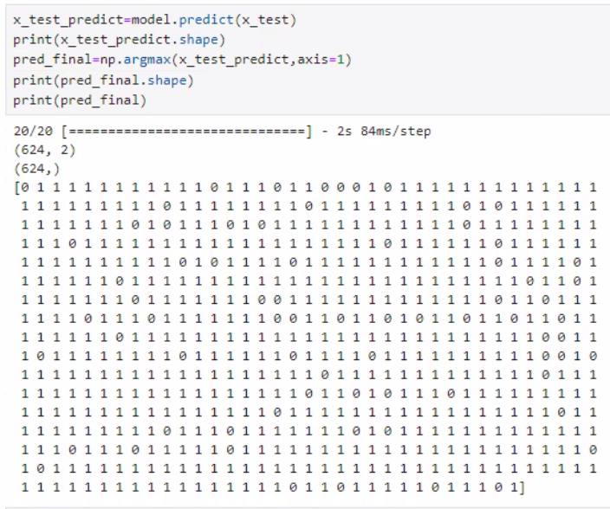
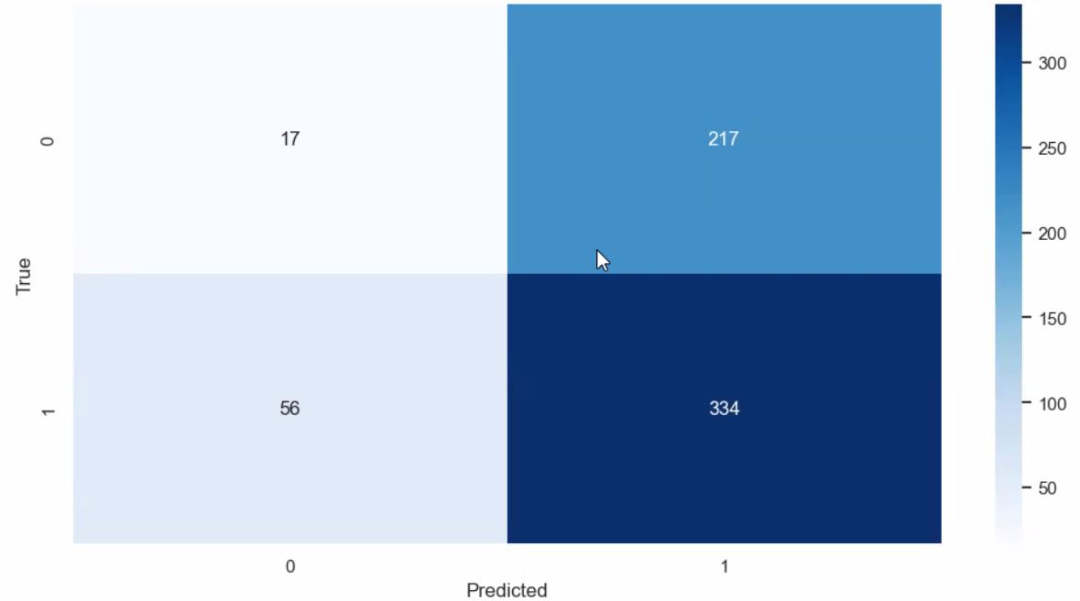
Predict
Achieved high accuracy in classification

Slide 14

Lessons Learned
GPU
Python version
Tensorflow

Slide 15

Future Research and Development
Question: How to improve accuracy further?
Plan: Explore other architectures, data augmentation techniques.

